Slide 1
Topic 8. Classification and Regression Trees (CART)

Slide 2
Tree-based Methods
Tree-based methods involve segmenting the predictor space into a number of simple regions.
In each region, we typically use the mean or the mode of the training observations in the region to make prediction.
Region-wise constant, and completely nonparametric
A medical example
Predict high risk patients who will not survive at least 30 days on the basis of the initial 24-hour data.
19 variables are measured during the first 24 hours. These include blood pressure, age, etc.

Slide 3
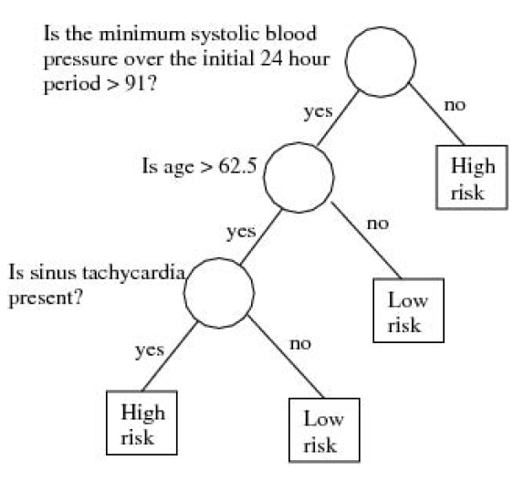
An Example of Classification Tree

Slide 4
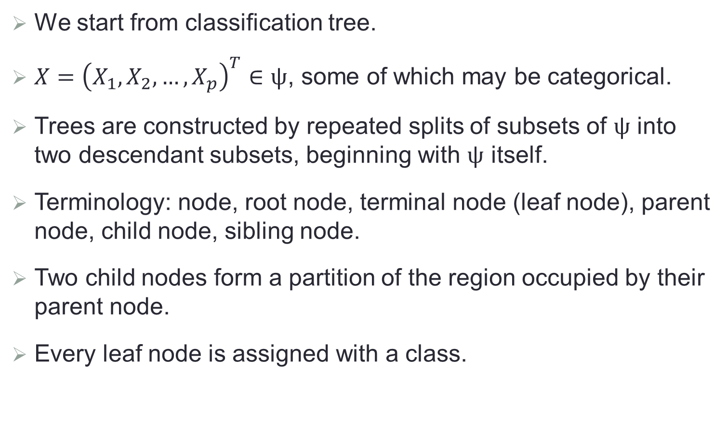
Some Notations
We start from classification tree.
$X={\left(X_{1},X_{2},…,X_{p}\right)}^{T}∈ψ$, some of which may be categorical.
Trees are constructed by repeated splits of subsets of $ψ$ into two descendant subsets, beginning with $ψ$ itself.
Terminology: node, root node, terminal node (leaf node), parent node, child node, sibling node.
Two child nodes form a partition of the region occupied by their parent node.
Every leaf node is assigned with a class.

Slide 5
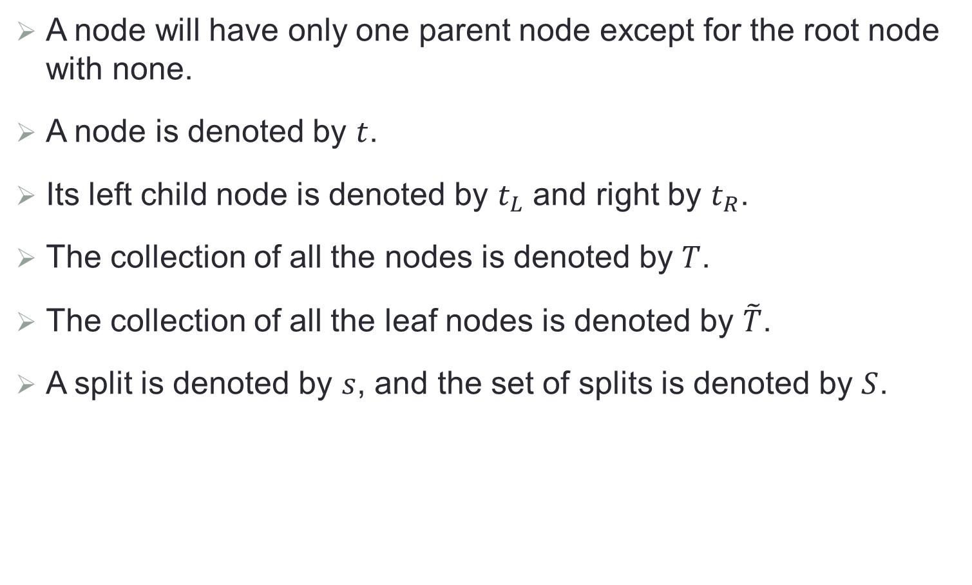
Some Notations (Cont.)
A node will have only one parent node except for the root node with none.
A node is denoted by $t$.
Its left child node is denoted by $t_{L}$ and right by $t_{R}$.
The collection of all the nodes is denoted by $T$.
The collection of all the leaf nodes is denoted by $\tilde{T}$.
A split is denoted by $s$, and the set of splits is denoted by $S$.

Slide 6
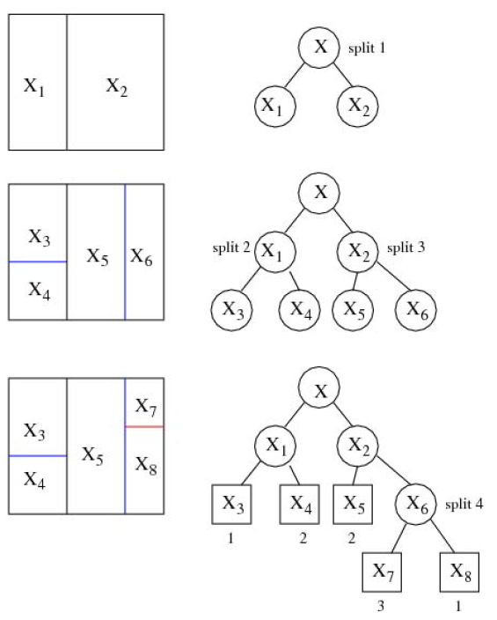
Tree Building

Slide 7
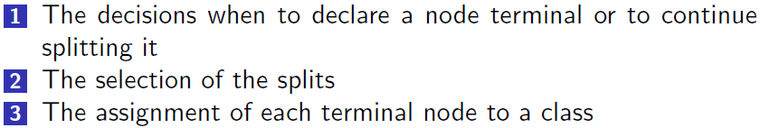
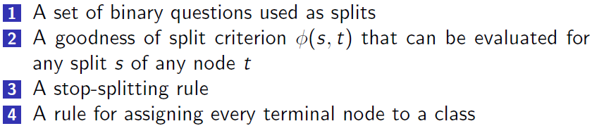
Key Elements of A Tree
The construction of a tree involves
In particular

Slide 8

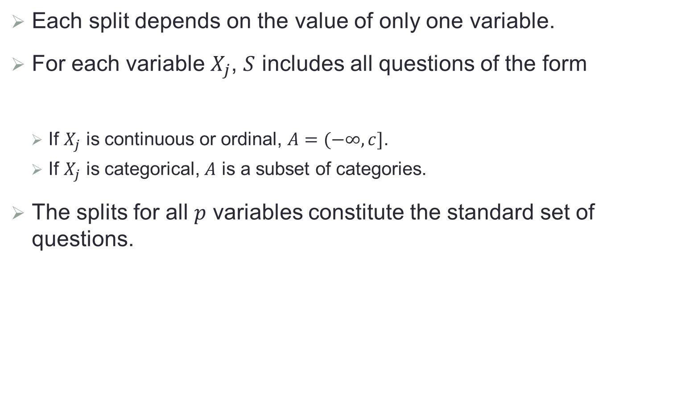
1. Standard Set of Questions
Each split depends on the value of only one variable.
For each variable $X_{j}$, $S$ includes all questions of the form
If $X_{j}$ is continuous or ordinal, $A=(−∞,c]$.
If $X_{j}$ is categorical, $A$ is a subset of categories.
The splits for all $p$ variables constitute the standard set of questions.
$$\{Is X_{j}∈A?\}$$

Slide 9
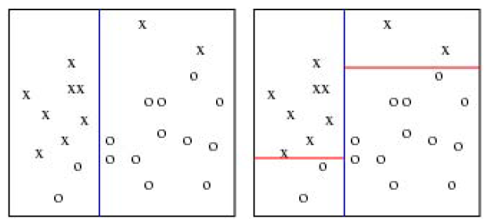
2. Goodness of Splits
The goodness of split is measured by an impurity function defined for each node.
Intuitively, we want each leaf node to be “pure”, that is, one class dominates.

Slide 10
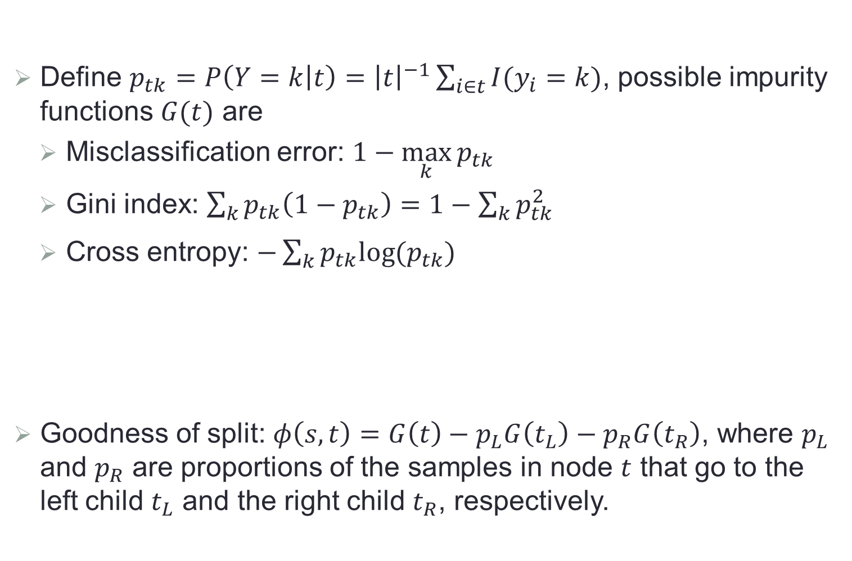
The Impurity Function
Define $p_{tk}=P\left(Y=k | t\right)={\left|t\right|}^{−1}\sum_{i∈t}{I(y_{i}=k)}$, possible impurity functions $G(t)$ are
Misclassification error: $1−\max_{k}{p_{tk}}$
Gini index: $\sum_{k}{p_{tk}\left(1−p_{tk}\right)=1−\sum_{k}{p_{tk}^{2}}}$
Cross entropy: $−\sum_{k}{p_{tk}log⁡(p_{tk})}$
Goodness of split: $φ\left(s,t\right)=G\left(t\right)−p_{L}G\left(t_{L}\right)−p_{R}G\left(t_{R}\right)$, where $p_{L}$ and $p_{R}$ are proportions of the samples in node $t$ that go to the left child $t_{L}$ and the right child $t_{R}$, respectively.

Slide 11
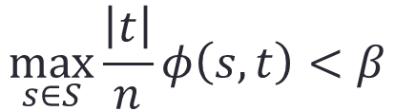
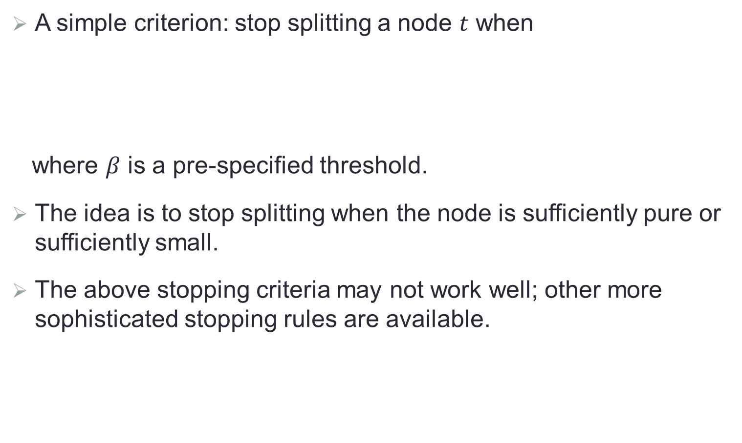
3. Stopping Criteria
A simple criterion: stop splitting a node $t$ when
where $β$ is a pre-specified threshold.
The idea is to stop splitting when the node is sufficiently pure or sufficiently small.
The above stopping criteria may not work well; other more sophisticated stopping rules are available.
$$\max_{s∈S}{\frac{\left|t\right|}{n}φ\left(s,t\right)<β}$$

Slide 12
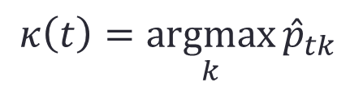
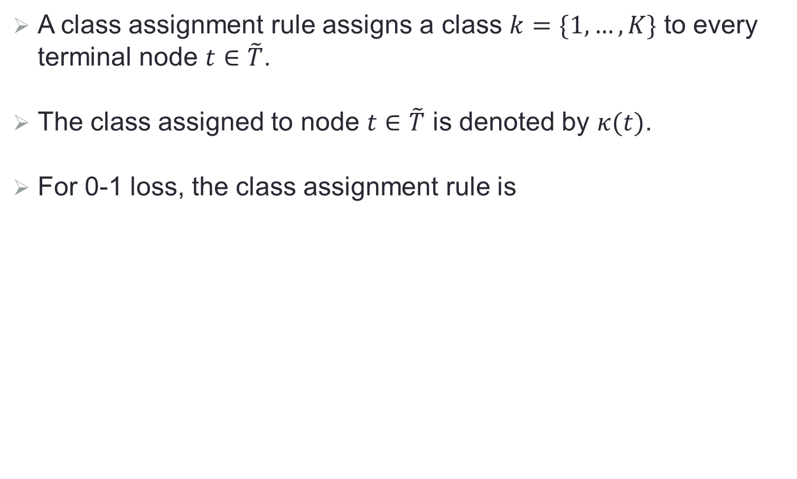
4. Class Assignment Rule
A class assignment rule assigns a class $k=\{1,…,K\}$ to every terminal node $t∈\tilde{T}$.
The class assigned to node $t∈\tilde{T}$ is denoted by $κ(t)$.
For 0-1 loss, the class assignment rule is
$$κ\left(t\right)=\underset{k}{argmax}{{\hat{p}}_{tk}}$$

Slide 13
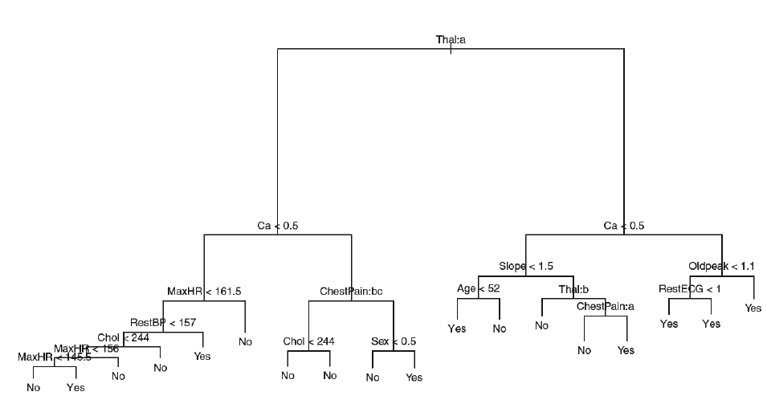
Example of Classification Tree

Slide 14
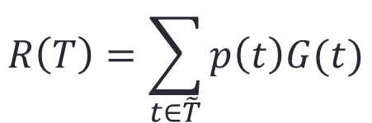
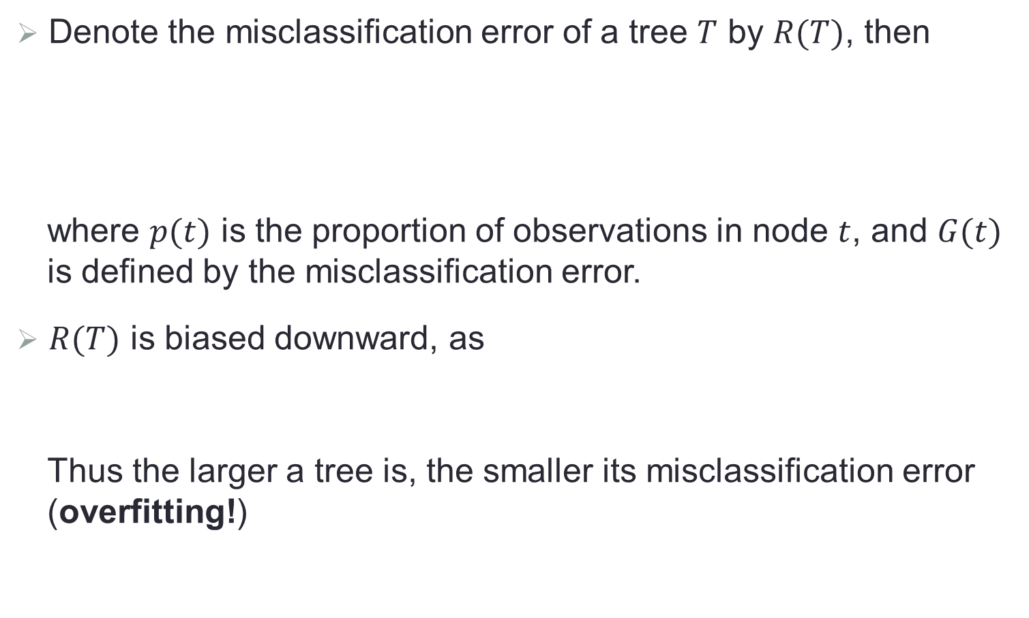

Right-sized Trees
Denote the misclassification error of a tree $T$ by $R(T)$, then
where $p(t)$ is the proportion of observations in node $t$, and $G(t)$ is defined by the misclassification error.
$R(T)$ is biased downward, as
Thus the larger a tree is, the smaller its misclassification error (overfitting!)
$$R\left(T\right)=\sum_{t∈\tilde{T}}{p\left(t\right)G(t)}$$
$$p\left(t\right)G\left(t\right)≥p\left(t_{L}\right)G\left(t_{L}\right)+p\left(t_{R}\right)G\left(t_{R}\right)$$

Slide 15
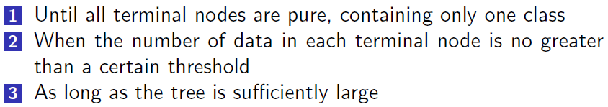
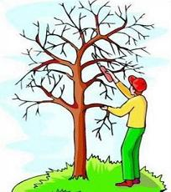
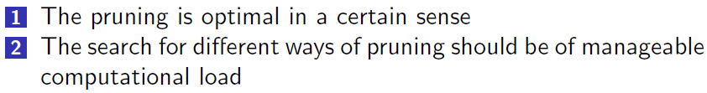
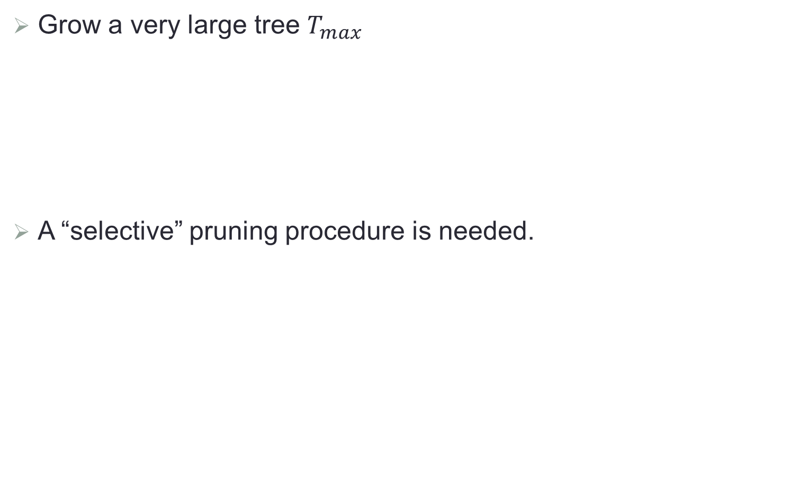
Pruning
Grow a very large tree $T_{max}$
A “selective” pruning procedure is needed.

Slide 16

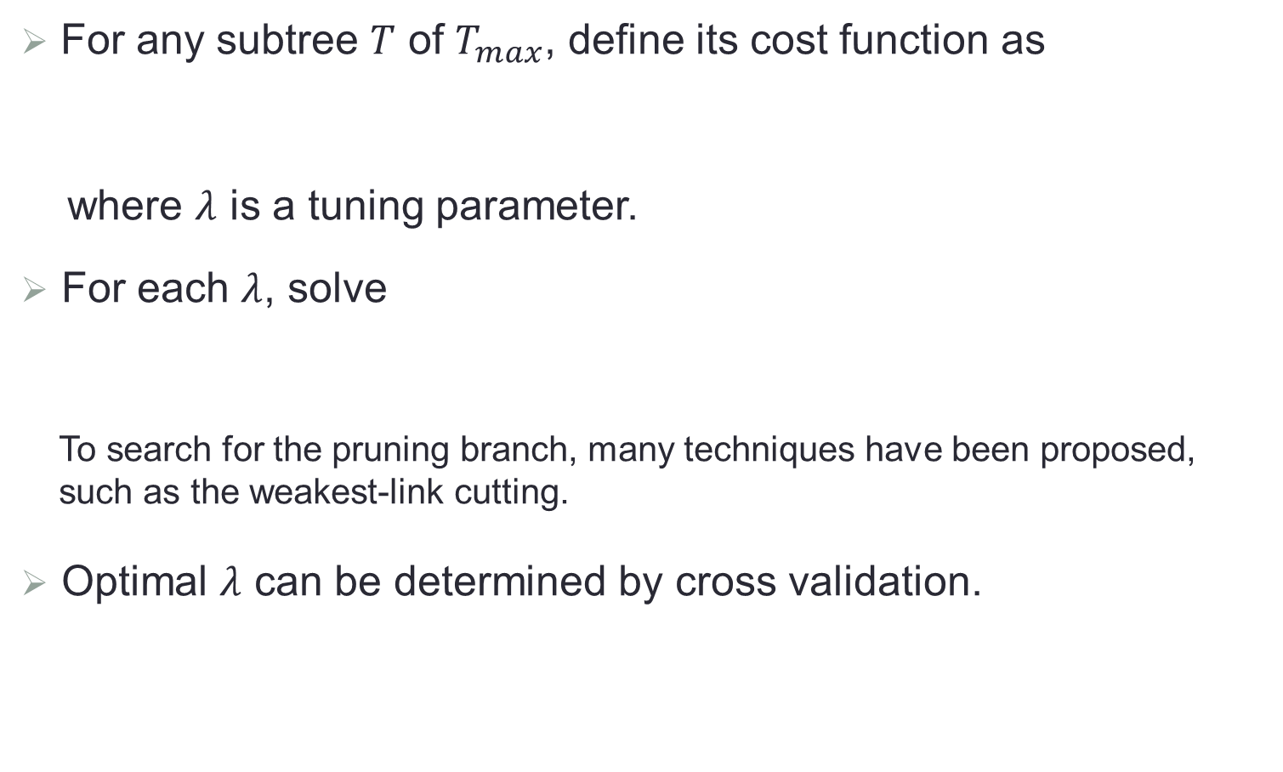
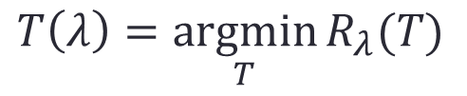
Minimal Cost Pruning
For any subtree $T$ of $T_{max}$, define its cost function as
where $λ$ is a tuning parameter.
For each $λ$, solve
To search for the pruning branch, many techniques have been proposed, such as the weakest-link cutting.
Optimal $λ$ can be determined by cross validation.
$$R_{λ}\left(T\right)=R\left(T\right)+λ\left|\tilde{T}\right|$$
$$T\left(λ\right)=\underset{T}{argmin}{R_{λ}(T)}$$

Slide 17
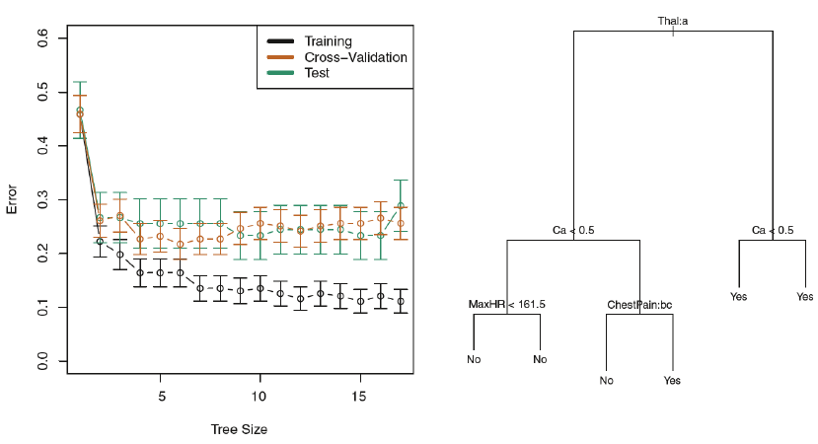
Example of A Pruned Tree

Slide 18

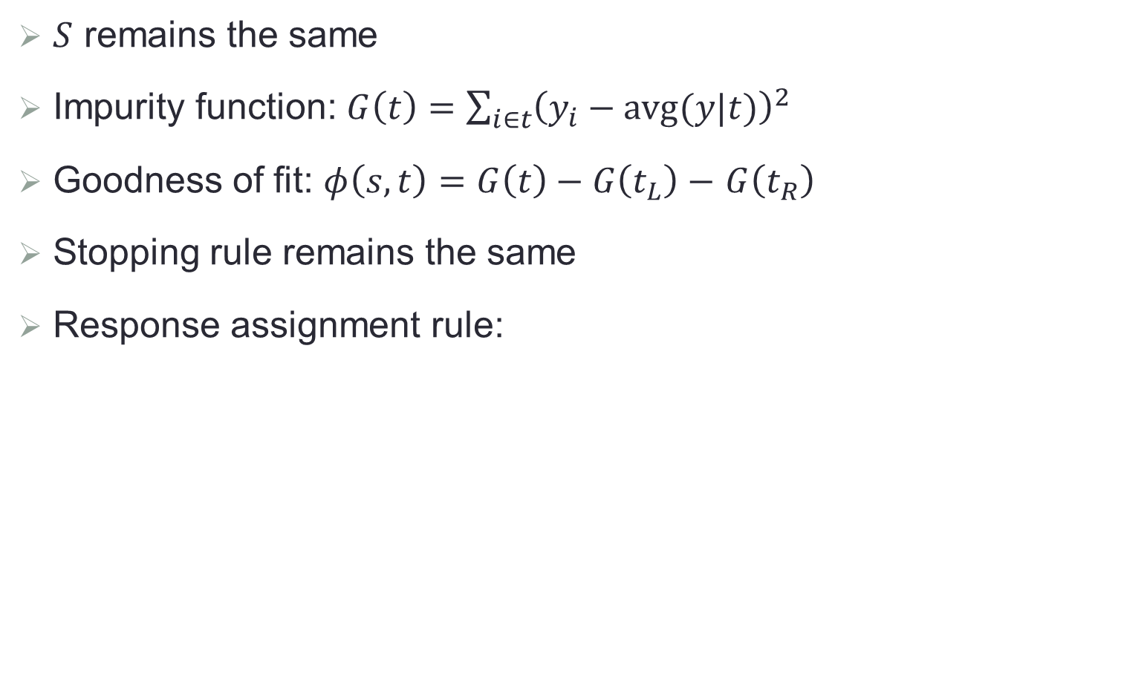
Extension to Regression Tree
$S$ remains the same
Impurity function: $G\left(t\right)=\sum_{i∈t}{{\left(y_{i}−avg(y|t)\right)}^{2}}$
Goodness of fit: $φ\left(s,t\right)=G\left(t\right)−G\left(t_{L}\right)−$ $G\left(t_{R}\right)$
Stopping rule remains the same
Response assignment rule:
$$κ\left(t\right)=avg(y|t)$$

Slide 19
Advantages of Tree-based Methods
Easy to interpret
Handle both categorical and ordered variables in a simple and natural way
Automatic stepwise variable selection and complexity reduction
Provide an estimate of conditional class probability
Very nice and intuitive graphical display

Slide 20
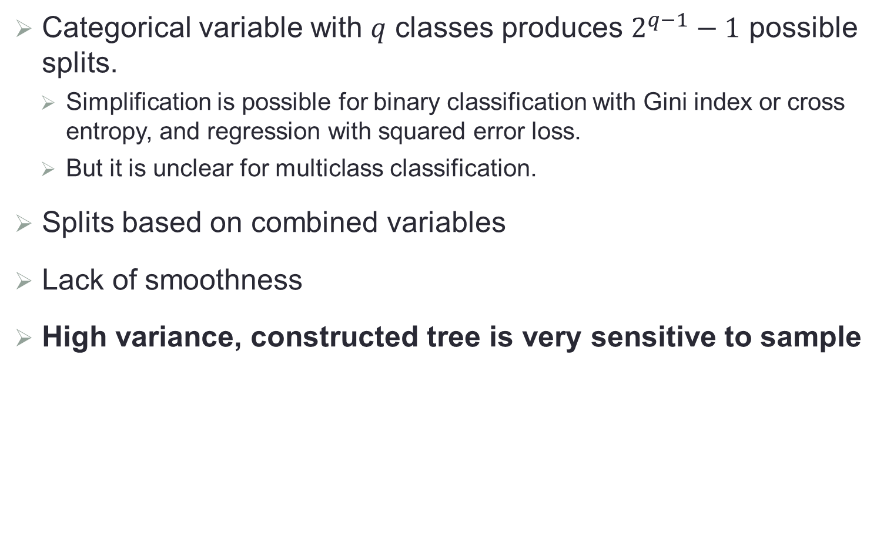
Issues of Tree-based Methods
Categorical variable with $q$ classes produces $2^{q−1}−1$ possible splits.
Simplification is possible for binary classification with Gini index or cross entropy, and regression with squared error loss.
But it is unclear for multiclass classification.
Splits based on combined variables
Lack of smoothness
High variance, constructed tree is very sensitive to sample

Slide 21
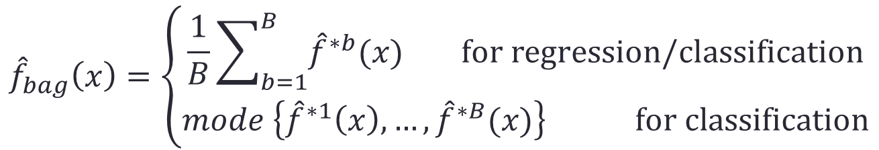
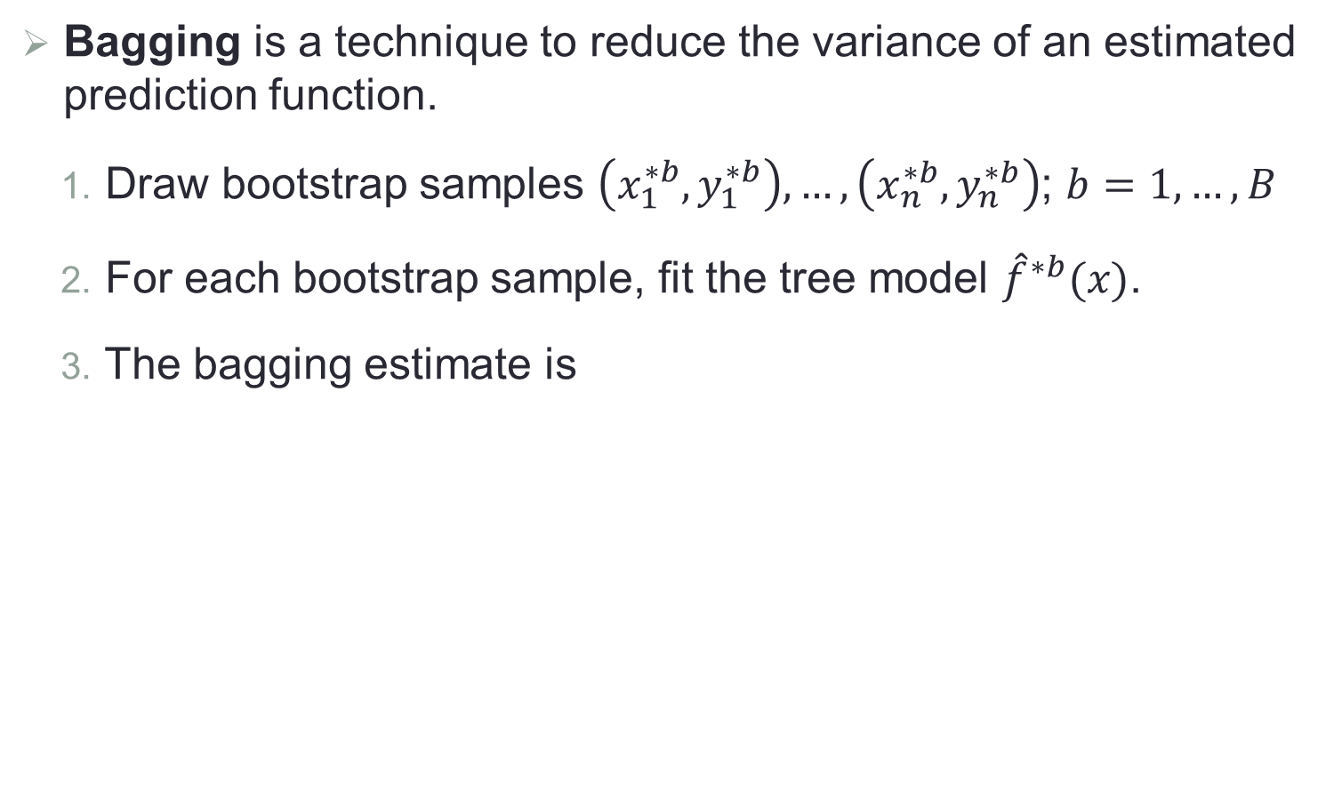
Bagging (Bootstrap Aggregation)
Bagging is a technique to reduce the variance of an estimated prediction function.
Draw bootstrap samples $\left(x_{1}^{∗b},y_{1}^{∗b}\right),…,\left(x_{n}^{∗b},y_{n}^{∗b}\right)$; $b=1,…,B$
For each bootstrap sample, fit the tree model ${\hat{f}}^{∗b}(x)$.
The bagging estimate is
$${\hat{f}}_{bag}\left(x\right)=\left\{\begin{matrix}\frac{1}{B}\sum_{b=1}^{B}{{\hat{f}}^{∗b}(x)} for regression/classification \\ mode \left\{{\hat{f}}^{∗1}\left(x\right),…,{\hat{f}}^{∗B}(x)\right\} for classification\end{matrix}\right.$$

Slide 22
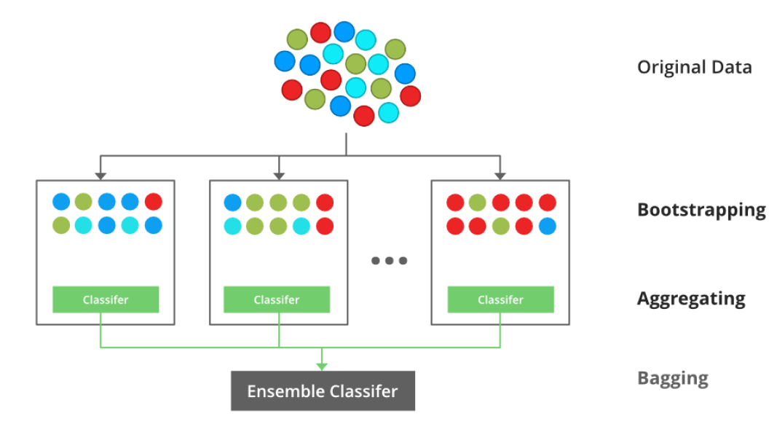
Idea of Bagging

Slide 23

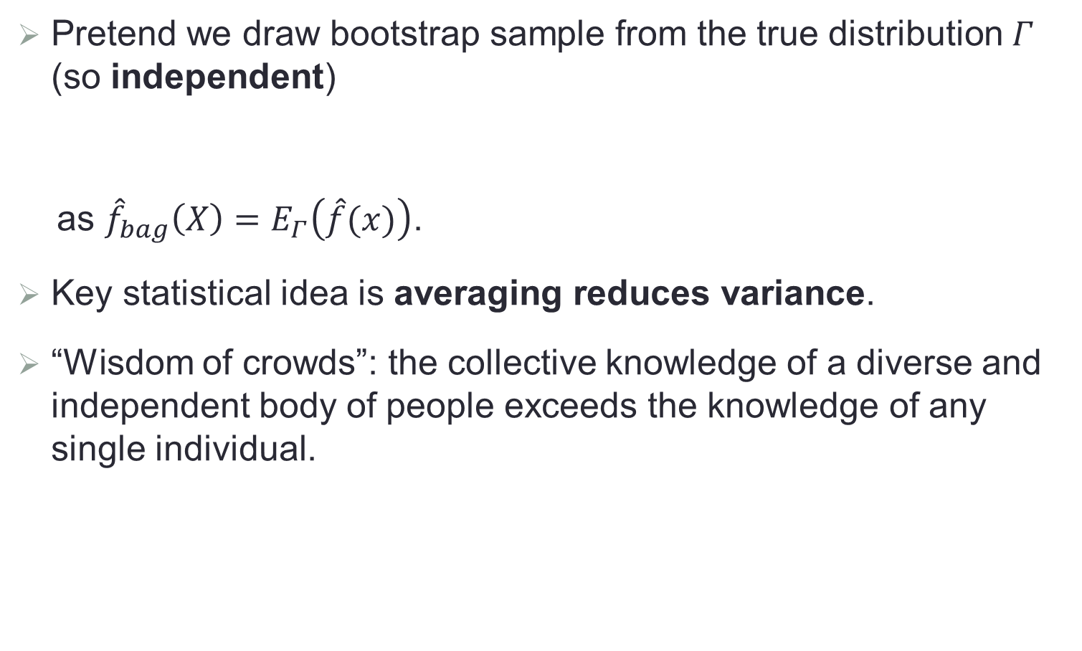
Why It Works: Some Intuitions
Pretend we draw bootstrap sample from the true distribution $Γ$ (so independent)
as ${\hat{f}}_{bag}\left(X\right)=E_{Γ}\left(\hat{f}(x)\right)$.
Key statistical idea is averaging reduces variance.
“Wisdom of crowds”: the collective knowledge of a diverse and independent body of people exceeds the knowledge of any single individual.
$$E{\left(Y−\hat{f}(X)\right)}^{2}≥E{\left(Y−{\hat{f}}_{bag}(X)\right)}^{2}$$

Slide 24
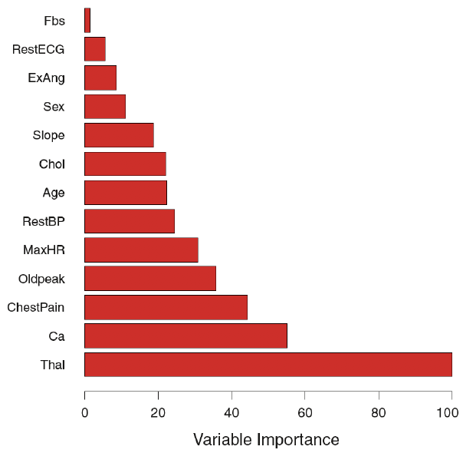
Variable Importance

Slide 25
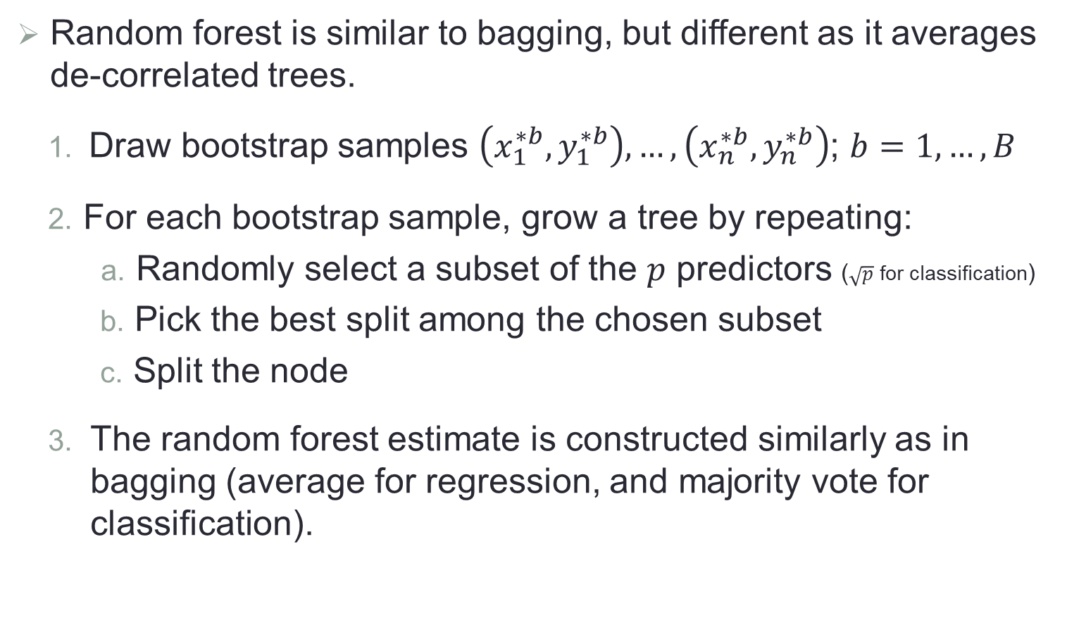
Random Forest
Random forest is similar to bagging, but different as it averages de-correlated trees.
Draw bootstrap samples $\left(x_{1}^{∗b},y_{1}^{∗b}\right),…,\left(x_{n}^{∗b},y_{n}^{∗b}\right)$; $b=1,…,B$
For each bootstrap sample, grow a tree by repeating:
Randomly select a subset of the $p$ predictors ($\sqrt{p}$ for classification)
Pick the best split among the chosen subset
Split the node
The random forest estimate is constructed similarly as in bagging (average for regression, and majority vote for classification).

Slide 26
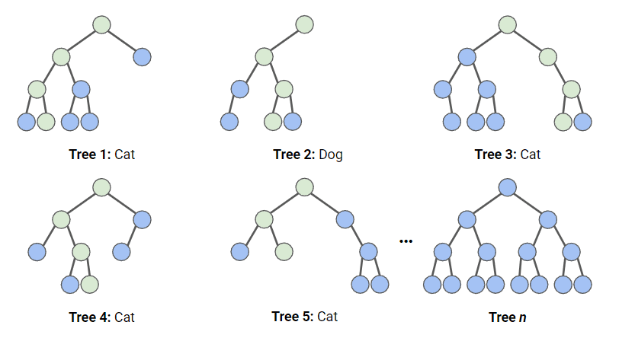
Idea of Random Forest

Slide 27
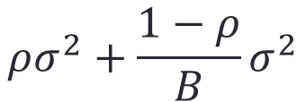
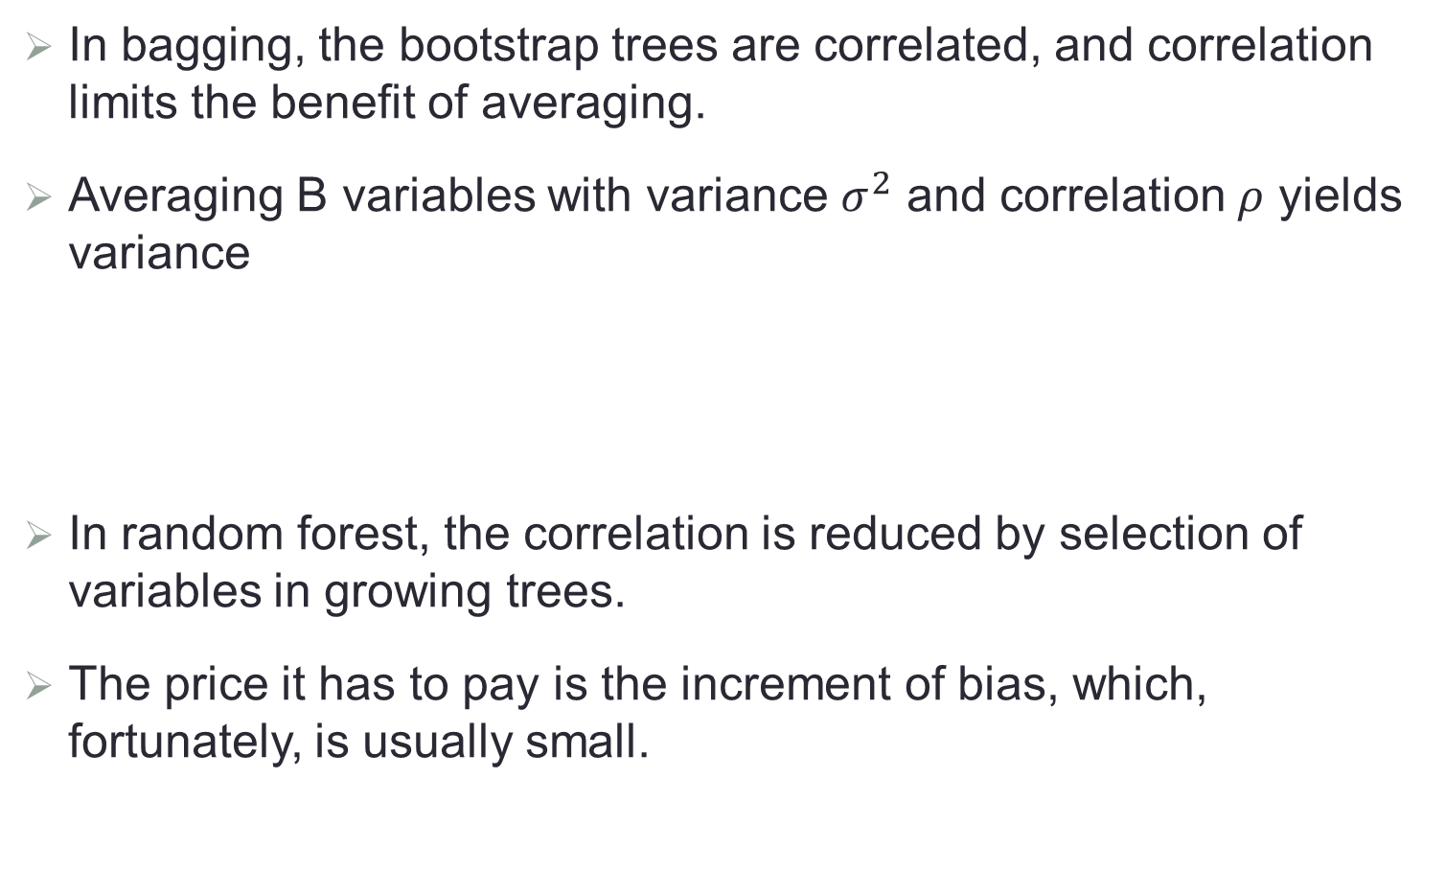
Why It Works: Some Intuition
In bagging, the bootstrap trees are correlated, and correlation limits the benefit of averaging.
Averaging B variables with variance $σ^{2}$ and correlation $ρ$ yields variance
In random forest, the correlation is reduced by selection of variables in growing trees.
The price it has to pay is the increment of bias, which, fortunately, is usually small.
$$ρσ^{2}+\frac{1−ρ}{B}σ^{2}$$

Slide 28
Boosting
Boosting also involves growing multiple trees, but sequentially and adaptively.
Each tree is grown using information from previously grown trees.
Boosting does not involve bootstrap sampling: each tree is fit on a modified version of the original dataset.
Iteratively learning weak classifiers
Final result is the weighted sum of the results of each weak classifiers.

Slide 29
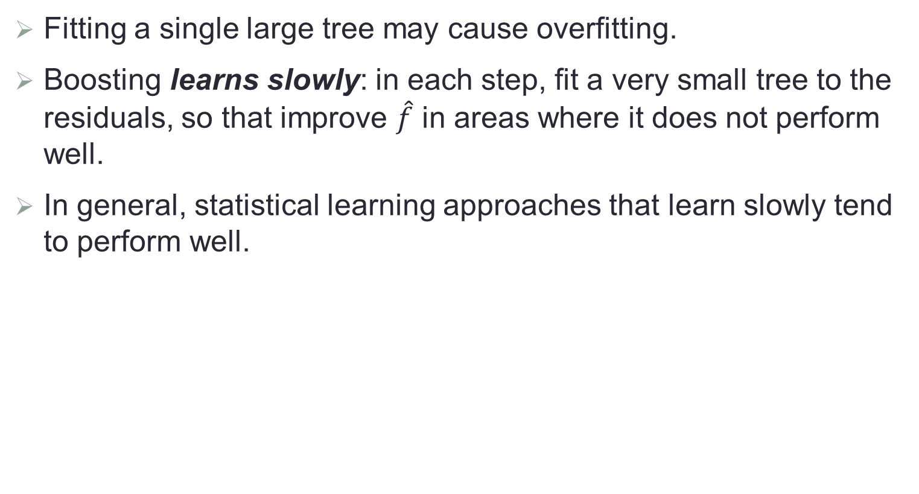
Idea behind Boosting
Fitting a single large tree may cause overfitting.
Boosting learns slowly: in each step, fit a very small tree to the residuals, so that improve $\hat{f}$ in areas where it does not perform well.
In general, statistical learning approaches that learn slowly tend to perform well.

Slide 30
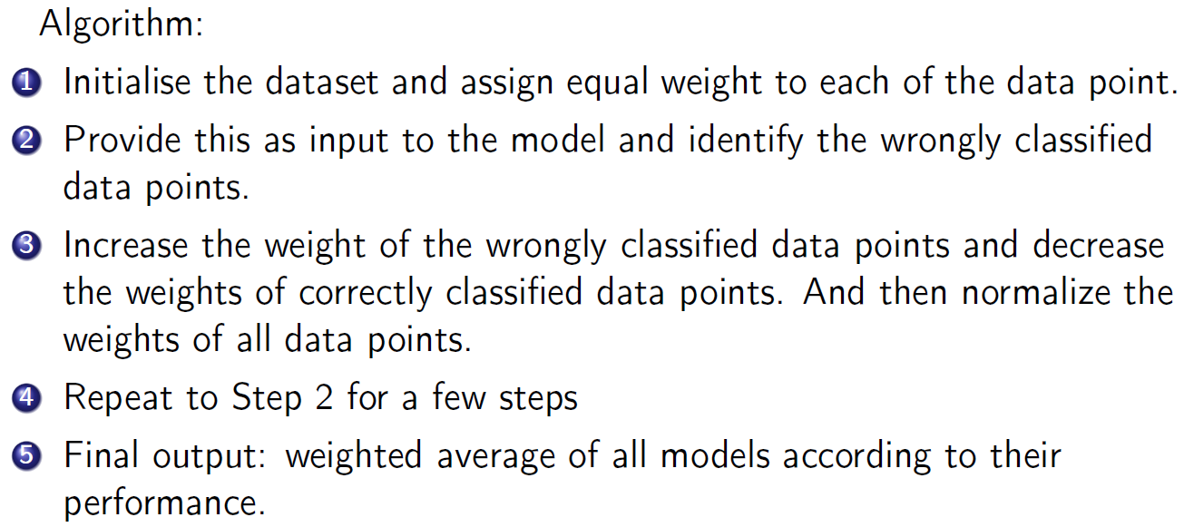
Boosting for Classification

Slide 31
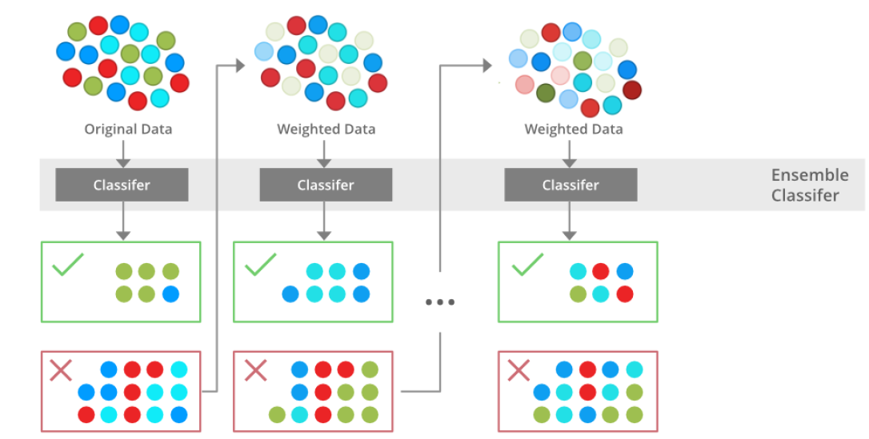
Boosting for Classification

Slide 32
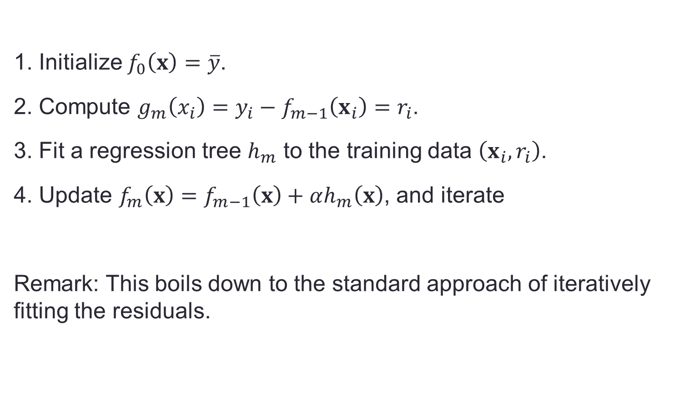
Boosting for Regression Tree
1. Initialize $f_{0}\left(x\right)=\overline{y}$.
2. Compute $g_{m}\left(x_{i}\right)=y_{i}−f_{m−1}\left(x_{i}\right)=r_{i}$.
3. Fit a regression tree $h_{m}$ to the training data $\left(x_{i},r_{i}\right)$.
4. Update $f_{m}\left(x\right)=f_{m−1}\left(x\right)+αh_{m}\left(x\right)$, and iterate
Remark: This boils down to the standard approach of iteratively fitting the residuals.

Slide 33
Boosting Algorithms
There are many boosting algorithms: adaboost (adaptive boosting) is the first (1996).
Examples of other boosting algorithms
LogitBoost (2000)
L2Boost (2002)
Gradient boosting (Gradient descent + Boosting)
Focus on binary classification and may be extended to multiclass case.

Slide 34
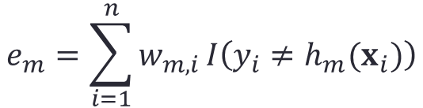
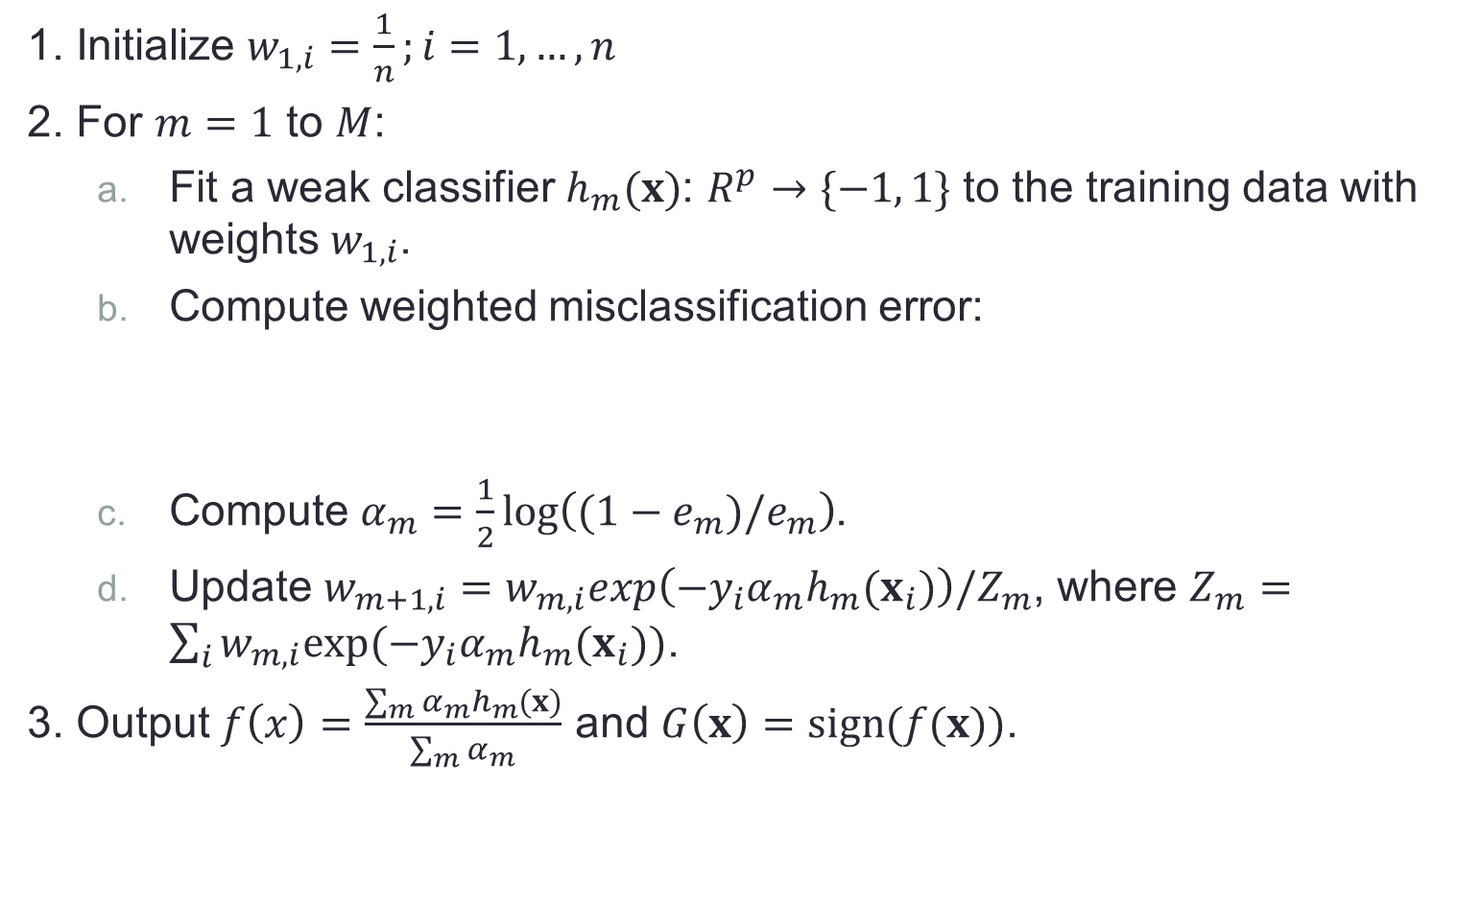
Adaboost.M1 for Binary Classification Trees
1. Initialize $w_{1,i}=\frac{1}{n};i=1,…,n$
2. For $m=1$ to $M$:
Fit a weak classifier $h_{m}(x)$: $R^{p}→\{−1, 1\}$ to the training data with weights $w_{1,i}$.
Compute weighted misclassification error:
Compute $α_{m}=\frac{1}{2}log\left((1−e_{m})/e_{m}\right)$.
Update $w_{m+1,i}=w_{m,i}exp\left(−y_{i}α_{m}h_{m}(x_{i})\right)/Z_{m}$, where $Z_{m}=\sum_{i}{w_{m,i}exp⁡(−y_{i}α_{m}h_{m}(x_{i}))}$.
3. Output $f\left(x\right)=\frac{\sum_{m}{α_{m}h_{m}(x)}}{\sum_{m}{α_{m}}}$ and $G\left(x\right)=sign(f(x))$.
$$e_{m}=\sum_{i=1}^{n}{w_{m,i}}I\left(y_{i}≠h_{m}(x_{i})\right)$$

Slide 35
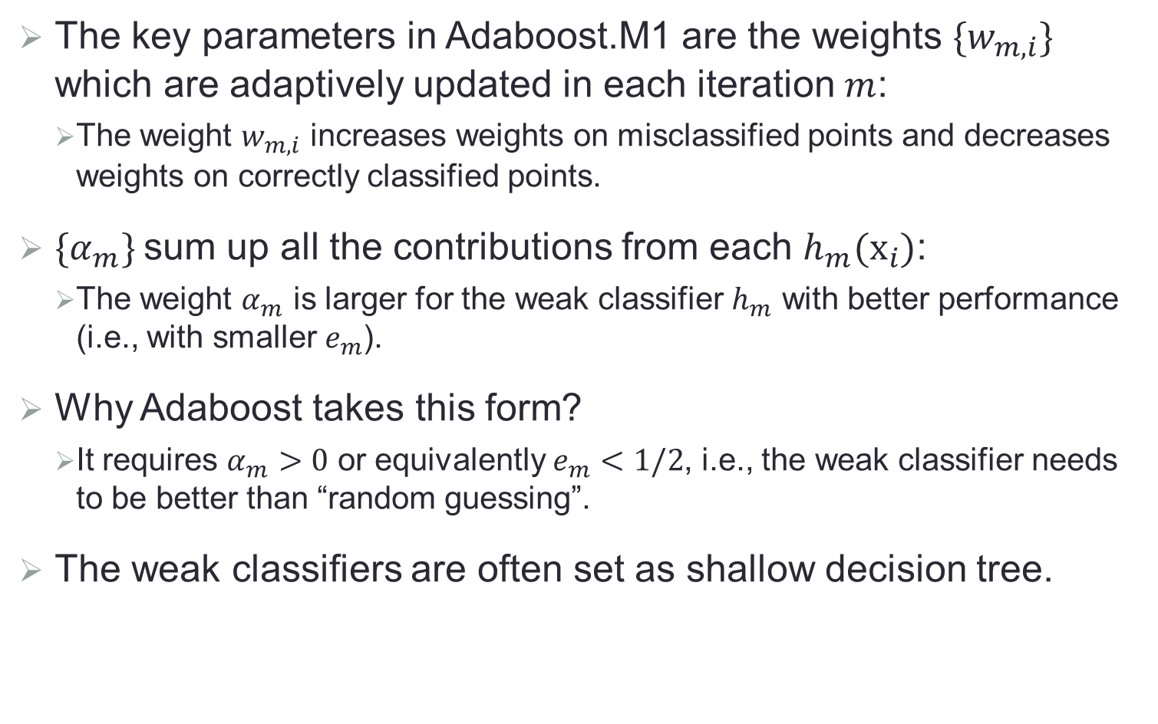
Weak Classifier and Weights
The key parameters in Adaboost.M1 are the weights $\{w_{m,i}\}$ which are adaptively updated in each iteration $m$:
The weight $w_{m,i}$ increases weights on misclassified points and decreases weights on correctly classified points.
${\{α}_{m}\}$sum up all the contributions from each $h_{m}(x_{i})$:
The weight $α_{m}$ is larger for the weak classifier $h_{m}$ with better performance (i.e., with smaller $e_{m}$).
Why Adaboost takes this form?
It requires $α_{m}>0$ or equivalently $e_{m}<1/2$, i.e., the weak classifier needs to be better than “random guessing”.
The weak classifiers are often set as shallow decision tree.

Slide 36
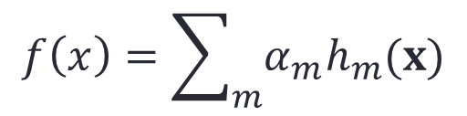
Recursive Idea
The final classifier takes the additive form
which can be written in a recursive form
which is a (forward stagewise) additive model.
Boosting is a way of fitting an additive expansion in a set of elementary “basis” functions.
$$f\left(x\right)=\sum_{m}{α_{m}h_{m}(x)}$$
$f_{m}\left(x\right)=f_{m−1}\left(x\right)+$ $α_{m}h_{m}(x)$ $m=1,2,…,M$

Slide 37
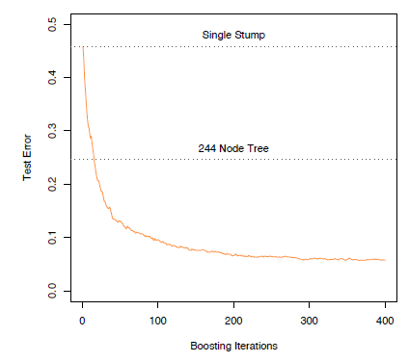
Performance of Adaboost
A simulated example
Stump: one-node tree

Slide 38
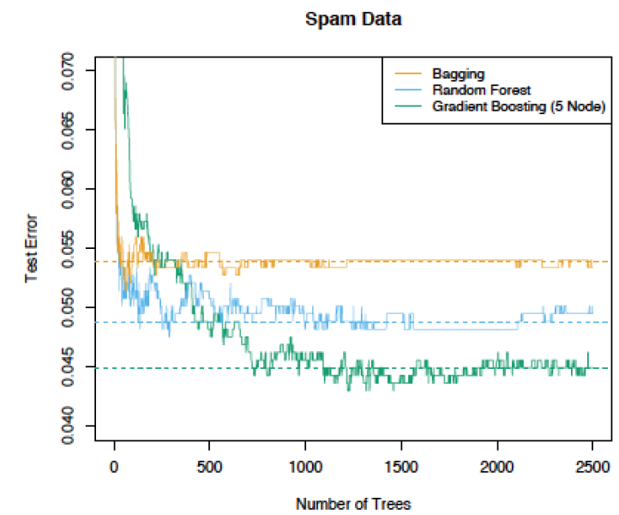
Spam Detection

Slide 39
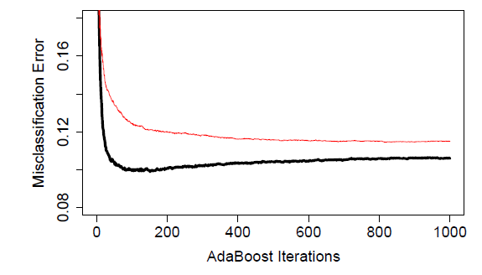
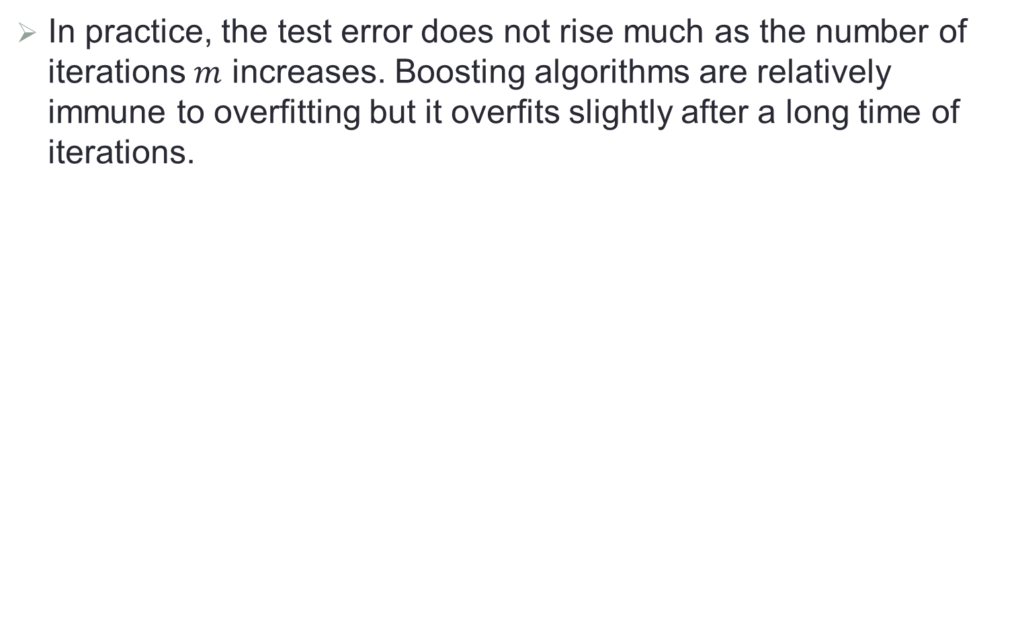
Does Boosting Overfit?
In practice, the test error does not rise much as the number of iterations $m$ increases. Boosting algorithms are relatively immune to overfitting but it overfits slightly after a long time of iterations.
Red line: Adaboost with 8-node trees
Black line: Adaboost with stumps

Slide 40

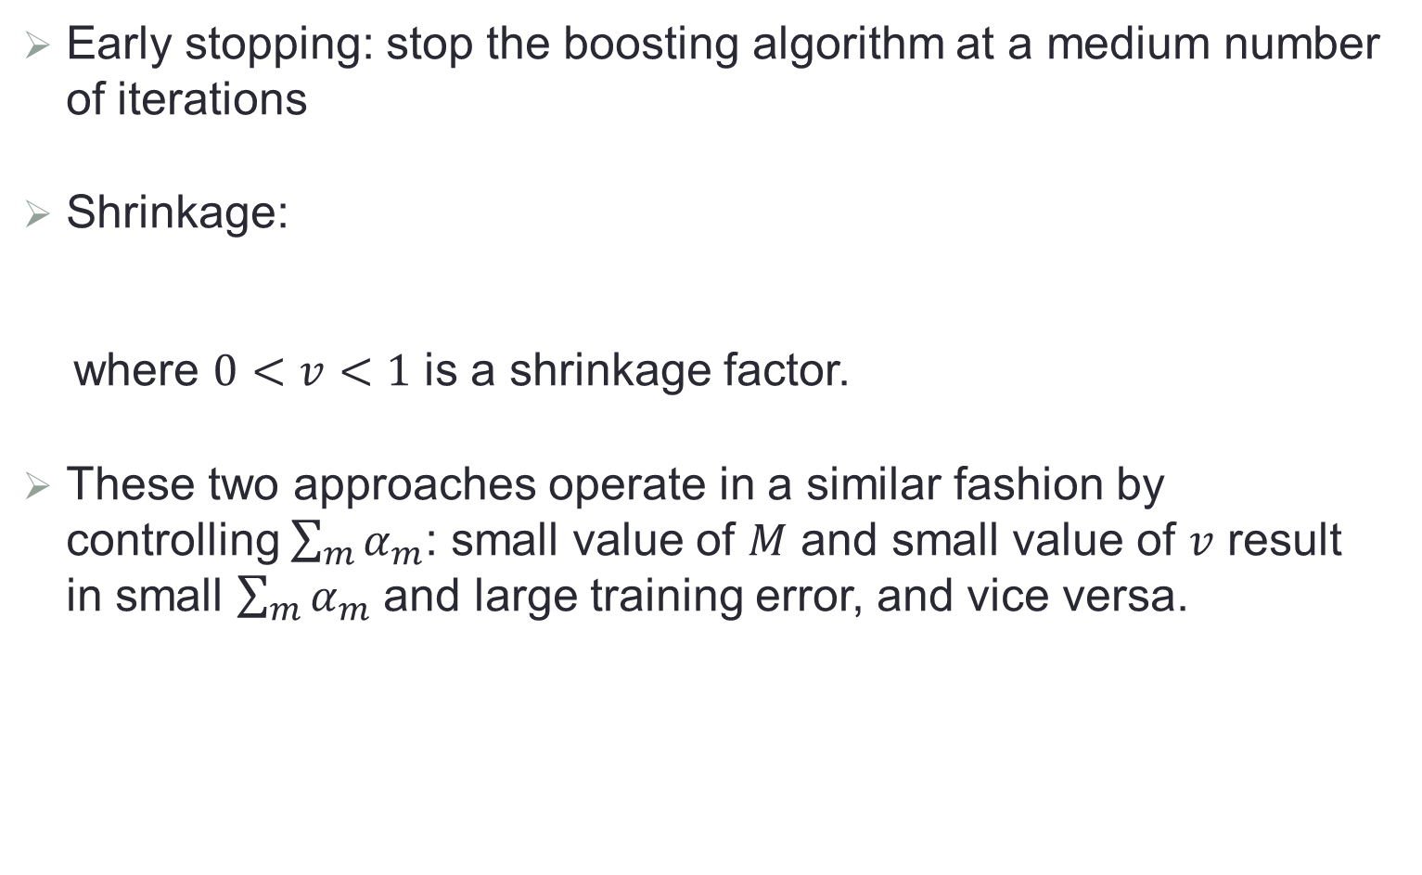
Regularization
Early stopping: stop the boosting algorithm at a medium number of iterations
Shrinkage:
where $0<v<1$ is a shrinkage factor.
These two approaches operate in a similar fashion by controlling $\sum_{m}{α_{m}}$: small value of $M$ and small value of $v$ result in small $\sum_{m}{α_{m}}$ and large training error, and vice versa.
$f_{m}\left(x\right)=f_{m−1}\left(x\right)+$ $v∙{α_{m}h}_{m}(x)$

Slide 41
Summary of Tree Ensemble Methods
Bagging: trees are grown independently on random samples of the observations. Consequently, the trees tend to be quite similar to each other. Thus, bagging can get caught in local optima and fail to thoroughly explore the model space.
Random forests: trees are once again grown independently on random samples of the observations. However, each split on each tree is performed using a random subset of the features, thereby decorrelating the trees, and leading to a more thorough exploration of model space relative to bagging.
Boosting: only the original data are used. The trees are grown successively, using a “slow” learning approach: each new tree is fit to the signal that is left over from the earlier trees, and shrunken down before it is used.

